Slide 1
intro to python
Strings and Conditionals
Shannon Turner
Twitter: @svthmc
GitHub: @shannonturner

Slide 2
Learn about variables
Learn how to display and modify text
Learn about conditionals
Learn how to use conditionals to change how your program behaves

Slide 3
Variables
Variables are containers for information; you can store text, numbers, or any other type of thing!
twitter = "@hearmecode"
members = 3000

Slide 4
The print command
Use the print command to show some information to the screen.
print "Welcome to Hear Me Code!"
print '3000 members and growing'
Since we created a variable on the previous slide, we can use it now:
print twitter
Notes:
(Remember that by this point, folks will have already printed "Watch out world" as part of setup, so this is review.)

Slide 5
The print command
Let's take a closer look at the difference between these two:
print twitter
print "twitter"
Notes:
One prints the contents of the variable, the other prints the actual text "twitter"

Slide 6
Strings: it's just text
Strings are a way to store information
Addresses
Email addresses
URLs
Names (people, places, …)
Phone Numbers
so much more (anything with text!)
Notes:
Strings are just Python's jargon word for "text"

Slide 7
Strings: it's just text
Strings are combinations of characters
Letters
Numbers
Punctuation
Basically anything you can make on the keyboard and then some
Special characters, like tabs and newlines

Slide 8
use quotes around strings
How to spot a string: it has quotes around it
"This is a string"
'This is also a string'
Using single or double quotes comes down to personal preference … as long as you start and end a string with the same quote
'Not like this :("

Slide 9
single or double quotes?
If your text contains a single quote, you'll want to use double quotes around your text: If you don't, you'll get an error: Try both of these out!
Notes:
Take time to let everyone try it out. Explain how Python gets confused and thinks the string ends early. Use your hands and point it out on the screen.
Make this error yourself, and step through how to read the error and understand what happened. Either comment out or delete the bad print statement before continuing.

Slide 10
use triple quotes for long strings
If you have a really long string, use three quote symbols in a row to start and end your string.
Notes:
Note how the string contains both single quotes and double quotes as part of the actual text, and that this would be difficult without using a triple quoted string.

Slide 11
special characters in strings
Special Characters
\n Newline
\t Tab
Notes:
Mnemonic: the backslash is by the backspace key

Slide 12
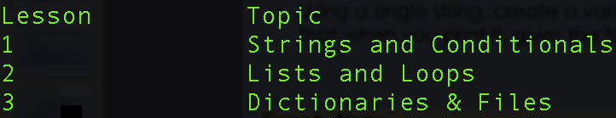
Strings: Quick Exercise
Print the following string:
Keep in mind you’ll need to use tabs & newlines!
Notes:
Emphasize that there are many ways to approach this, including using a triple-quoted string or by adding special characters within a single-quoted string.
Re-emphasize this once you bring it back. Be sure to mention that if things didn't line up how you wanted them to, that you can play with the spacing until it looks the way you want it.

Slide 13
How long is my string?
twitter = "@hearmecode"
print len(twitter)
len() works on lists, too! We'll work with lists in Lesson 2.
Notes:
len( ) measures the length of whatever is inside the parentheses.
Hey Python, can you measure the length of something for me?
Sure, what do you want me to measure?
Please measure what's in the variable twitter.

Slide 14
Strings: slicing
twitter = "@hearmecode"
Slicing lets you see individual pieces or “slices” of your string*
*Slicing also works with lists in the same way.
Notes:
Slicing is like writing a single character — letters, spaces, numbers, punctuation, everything — on each slice of bread in a loaf.
Use your hands a lot.

Slide 15
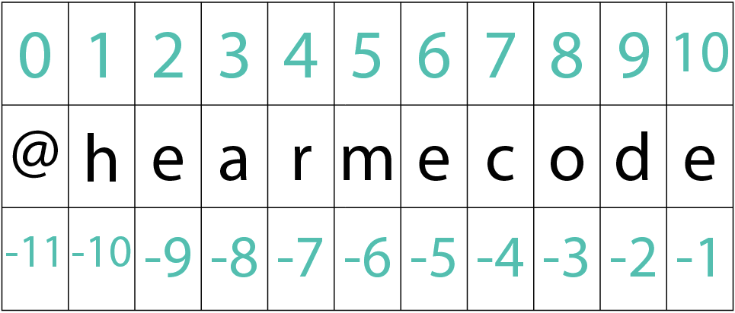
Strings: slicing
twitter = "@hearmecode"
print twitter[0]
Here, 0 refers to the index that you want to see
Slicing on first_name and last_name can give us a person’s initials; slicing on phone number can give us the area code
Notes:
When slicing, Python starts counting at zero. This is tricky to remember at first, but you'll get used to it! Mention that "index" is just Python's jargon term for "slicing number" or "position."

Slide 16
Strings: slicing
You can get more than one item in a slice
twitter[1:5]
The index on the left (1) is where you start
The index on the right (5) is where you end, but Python stops short and doesn’t include it
Notes:
Emphasize that the second slicing number isn't inclusive — the returned value stops just short of the second slicing number.
Mnemonic: How many characters do you get back? 5 - 1 = 4

Slide 17
Strings: slicing
The indices you provide are optional!
twitter[:5]
The left index is not provided, so Python assumes you want to start at the beginning and stop just short of item 5

Slide 18
Strings: slicing
The indices you provide are optional!
twitter[1:]
The right index is not provided, so Python assumes you want to start at item 1 and go to the end
Notes:
Once you’ve explained this slide, this is where you’ll have six teaching assistants come up to hold up the sheets of paper spelling out P Y T H O N
Have them also hold up their slicing number, and ask them to act out different slices. Don’t make them too complicated, but it’s a fun way to get audience participation and explain the concept another way.

Slide 19
Strings: slicing Exercise
phone = "(202) 456-7890"
Use slicing to print out the area code
And then the middle three numbers
All finished? Print out the last four digits

Slide 20
Strings: .format( )
Think of the numbers as placeholders for your variables (or like Mad libs!)
Remember, Python starts counting at zero. So zero is the first variable, which corresponds to name
Notes:
Be sure to mistakenly print "My name is: {0} and my age is: {1}" without the .format( ) to emphasize what .format( ) actually does.

Slide 21
Strings: .format( ) and slicing
You can use slicing with .format()
What does phone[4:] evaluate to?
Notes:
When in doubt, print it out. So let's print out phone[4:] in between lines 1 and 2 just to see what it is. Okay, it's 555-6789. So we're going to drop "555-6789" into the placeholder.

Slide 22
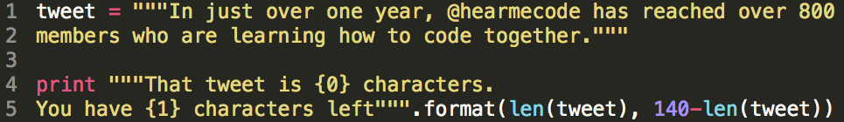
Strings: .format( ), functions, and math
You can also do math inside .format()!
And use functions!
And so much more!
Notes:
Explain that a tweet has to be 140 characters or fewer, so this can help us see how many characters we have left.

Slide 23
Strings: formatting Exercise
phone = "202-555-9876"
Use .format() and slice the phone variable to print these:
Area Code: 202
Local: 555-9876
Different format: (202) 555-9876
Notes:
Why do we need to use quotes around the phone? What happens when we don't?
Be sure to point out that the "different format" has parentheses around the area code, whereas there aren't any parentheses in our phone to begin with.

Slide 24
Strings: STRING Methods
String methods let you perform special actions on your strings
Replace one part of a string with another
Find one part of a string within the string
Count the number of times one part of a string appears within the string
… and many more!

Slide 25


String method: .find( )
.find(): Like Ctrl+F in most programs
The number you get back is the index (slice) where you found the item.
Notes:
Hey Python, can you find the at symbol in the variable email?
Python will tell you the position (slicing number) of where it found what you were looking for. If Python couldn't find it, you'll get -1 to say "I couldn't find that."

Slide 26
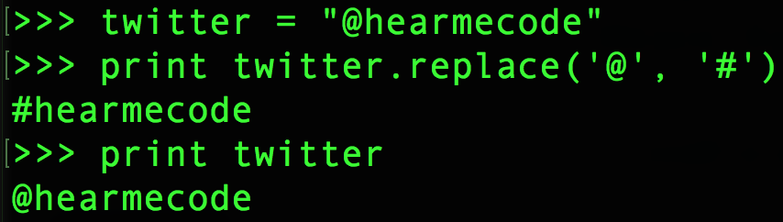
string method: .replace( )
.replace(): Like Find+Replace in Word, Excel, etc. … wait a second! Why didn't it save the changes?
Notes:
Our hashtag is the same as our twitter handle, so we can use the variable for both purposes!

Slide 27
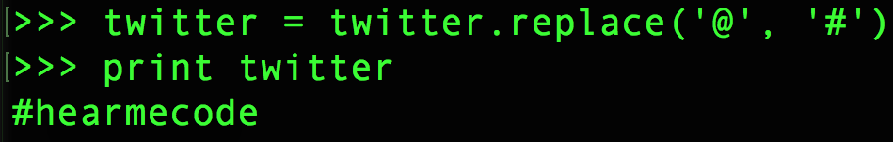
string method: .replace( )
Change it just for now:
Making the changes stick:
Notes:
Be sure to spend some time on this and have folks try it out. The reasons behind it are a bit out of scope for lesson 1, but allude to the fact that both behaviors are useful, and just knowing that we can do either is helpful.

Slide 28
how functions work
Arguments/parameters tell a function or method how to do their action, or what to do it to.
len(tweet)
Function (action): len()
Argument/parameter: tweet
Notes:
Hey Python, can you measure the length of something?
Sure, what would you like me to measure?
Can you tell me how long the variable tweet is?

Slide 29
Arguments
Arguments/parameters tell a function or method how to do their action.
twitter.replace("@", "#")
String method (action): .replace()
Argument/parameter: "@" and "#"
Where does Python perform the find/replace? On the string that comes before the dot!
Notes:
Hey Python, can you look for every at symbol in a string and replace them all with hashtags?
Sure, which string do you want me to do that to?
In the variable twitter, because that's what comes before the .replace( )

Slide 30
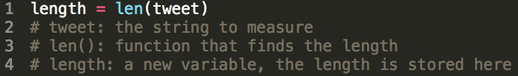
return values
Some functions and methods give you return values when they’re finished so you know what happened.
You can save this return value into a variable.
Notes:
Hey Python, can you measure the length of the variable tweet?
And once you've done that, can you save that into the variable length?
Thanks, now I can re-use that without having to calculate it each time.

Slide 31
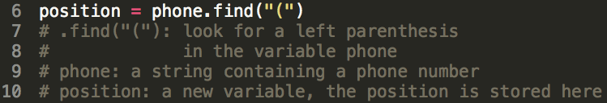
return values
Some functions and methods give you return values when they’re finished so you know what happened.
You can save this return value into a variable.
Notes:
This example will find the start of the area code.

Slide 32
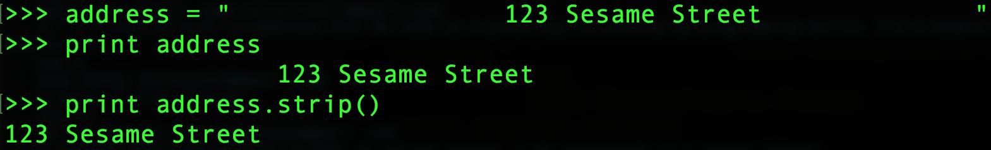
String method: .strip( )
.strip()
Removes whitespace from the beginning and end of a string (not the middle)

Slide 33
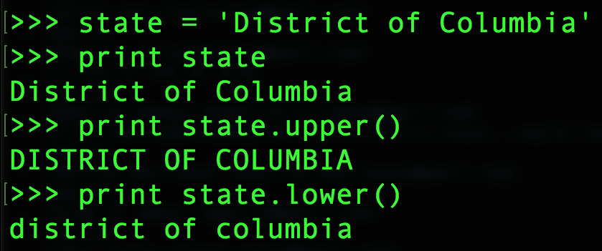
string methods: .lower( ), .upper( )
.lower()
.upper()
Converts a string to all lowercase or all uppercase

Slide 34
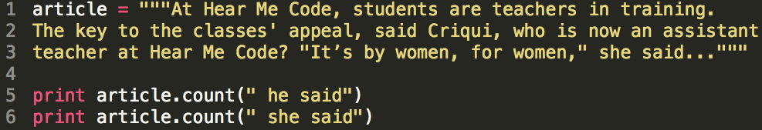
String method: .count( )
.count()
How many times was a woman quoted in this article?
How many times was a man quoted?

Slide 35
cONDITIONALS
We use conditionals to compare two things
Conditionals allow us to change our program's behavior based on the results

Slide 36
cONDITIONALS
Conditional: just a fancy name for a yes or no question
Conditionals are ways to compare things and use that information to make decisions
Conditionals can let you change the behavior of your program

Slide 37
cONDITIONALS
Ways to think about conditionals
Is this a valid email address?
Does my phone number have enough digits?
Are more people signed up for my event than the room can hold?

Slide 38
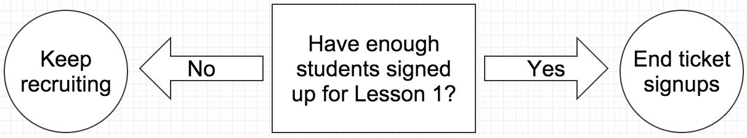
cONDITIONALS

Slide 39
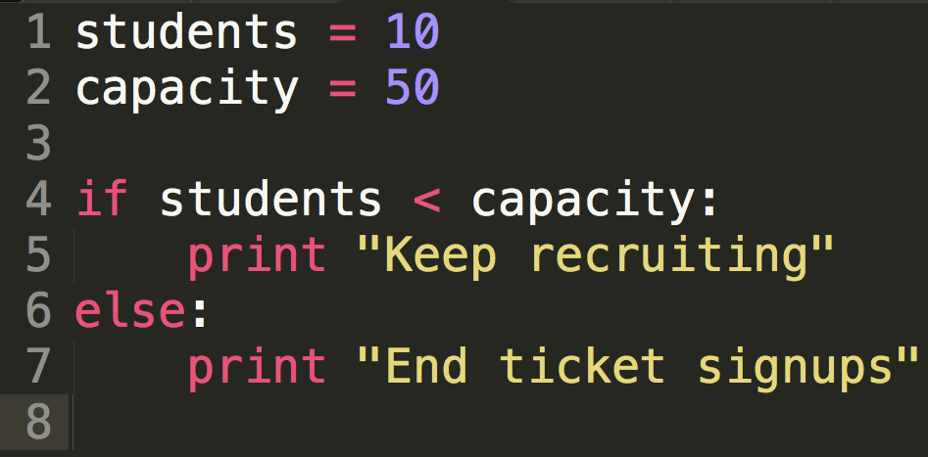
cONDITIONALS
Notes:
Note the indentation in lines 5 and 7. Python cares a lot about indentation, it's how it knows that the statement in line 5 belongs to the conditional in line 4.
A common mistake is adding a condition to the "else" portion.
Else is used as the catch-all for all other conditions that didn't match.

Slide 40
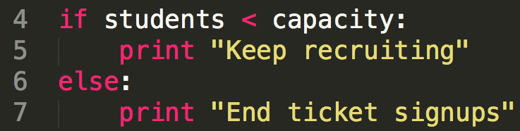
cONDITIONALS
Conditionals are paired with if statements, which ask whether or not the conditional is true
True or False: do we have more capacity than students?
Notes:
The most common mistake when writing conditionals is forgetting the colon at the end.

Slide 41
cONDITIONALS
Operators (ways to compare two things)
== Equality operator (don’t confuse with a single equals sign)
5 == 7 # Python says: False
5 == 5 # Python says: True
Notes:
Mnemonic for ==: are these two things equal?

Slide 42
cONDITIONALS
Operators (ways to compare two things)
> Greater than operator
5 > 7 # Python says: False
5 > 2 # Python says: True

Slide 43
cONDITIONALS
Operators (ways to compare two things)
== These two things are equal
!= NOT! equal to
> Greater than
< Less than
>= Greater than or equal to
<= Less than or equal to
Notes:
Be sure to announce the mnemonic for !=:
This is NOT! equal
This is also a good time to rehash the equality operator. These TWO things are equal.

Slide 44
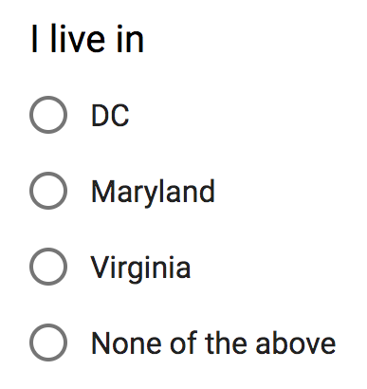
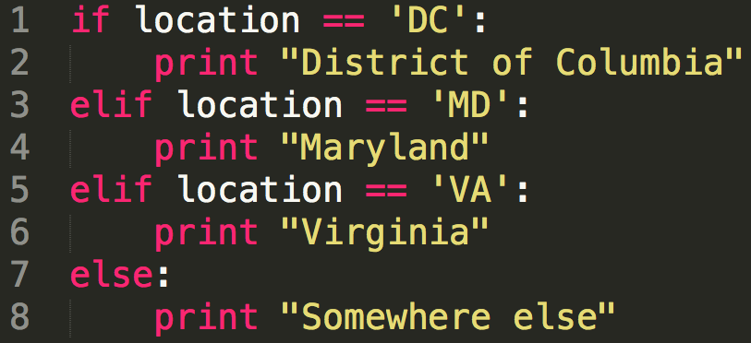
Multiple Choice: ELIF
Notes:
Thinking about multiple choice forms can be helpful to thinking about how we can use conditionals to change Python's behavior.
In the previous example, we saw if and else. Now we'll take a look at elif, which is used to create a multiple-choice structure.
We're pretty familiar with the image on the left: you can only choose one. Do you live in DC, or Maryland, or Virginia, or somewhere else?
And the image on the right is exactly the same -- just in Python code.

Slide 45
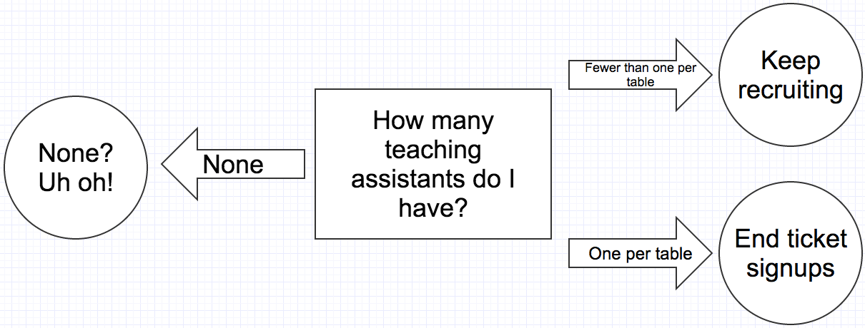
cONDITIONALS
Notes:
Here's a flowchart that shows a conditional with more than one option.

Slide 46
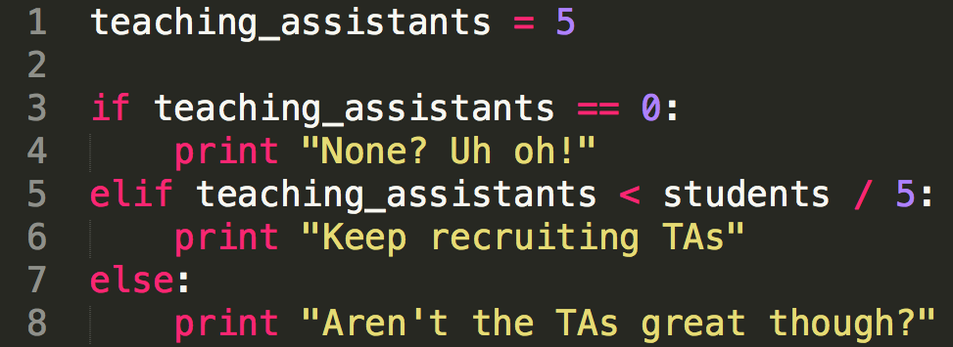
cONDITIONALS
Notes:
Our first conditional in line 3 asks "is teaching assistants exactly equal to zero"? If that's not true, then the "elif" statement in line 5 will ask, "is teaching assistants less than students divided by 5 (which is roughly 5 students per table?)". Elif is like "but, if".
If neither of those is true, then lines 7-8 will run.

Slide 47
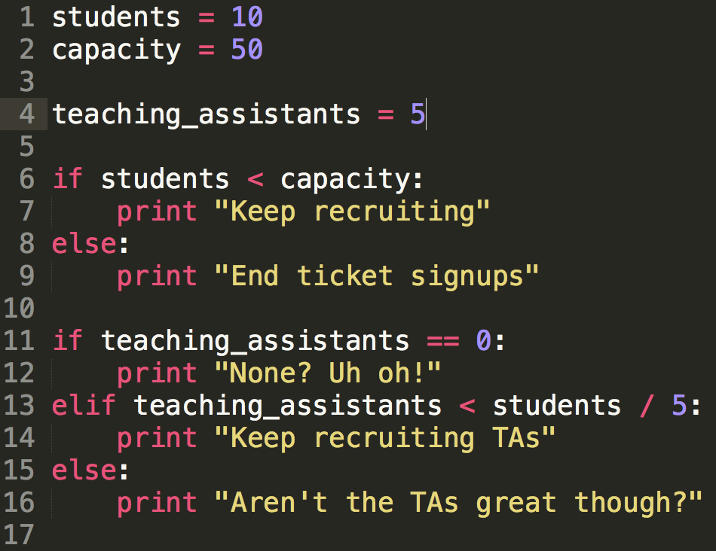
cONDITIONALS
Notes:
Let's put those two flowcharts together.
Important to note here: Lines 6-9 and 11-16 are evaluated separately.
In other words, the questions are asked separately.

Slide 48
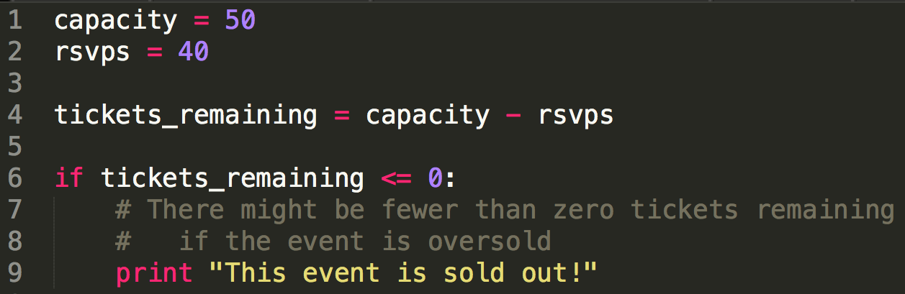
More examples of cONDITIONALS
Notes:
Remind students that comments are good for designing the structure of your program before you actually write the code.

Slide 49
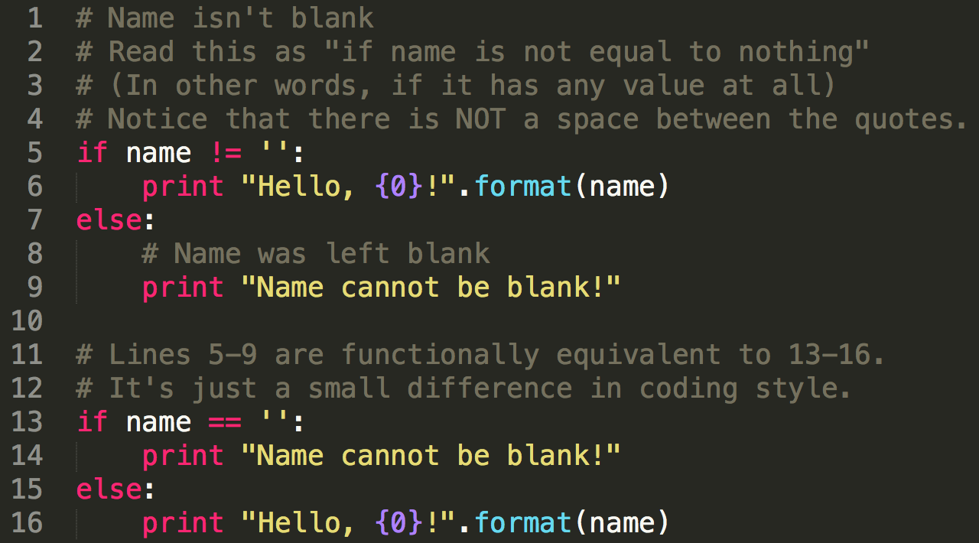
More examples of cONDITIONALS
Notes:
Remind students that comments are good for designing the structure of your program before you actually write the code.

Slide 50
cONDITIONALS: exercise
Create two variables (volunteers, goal)
Tell the user whether they are above, below, or at their recruitment goal.
Example: Volunteers: 90 Goal: 100
>>> You are behind!
Notes:
Play around with your numbers and test! Did you get the results you were expecting?
As a stretch goal, how many volunteers are you above or behind by?

Slide 51
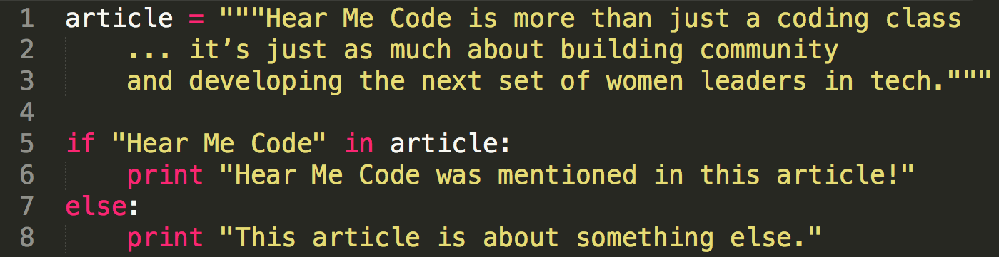
using The IN keyword
The in keyword, when used with a conditional, tells you whether some text appears in a string.

Slide 52
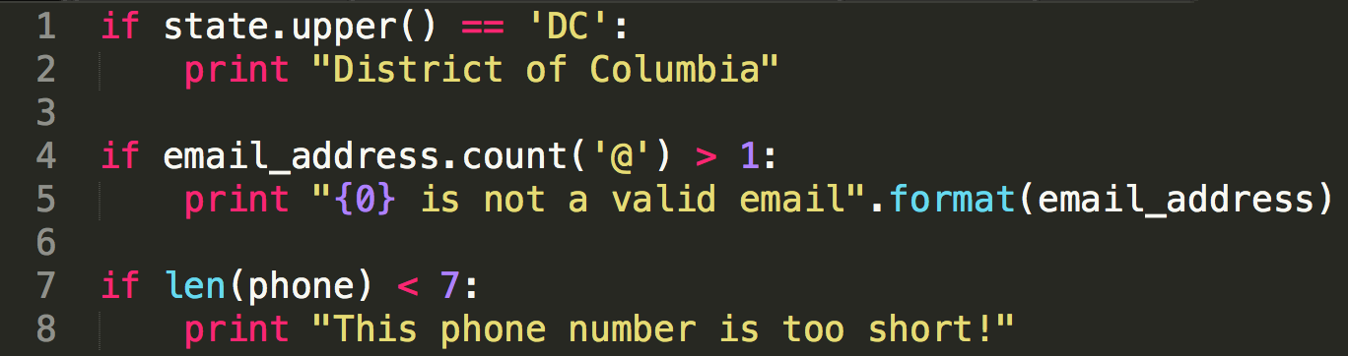
complex cONDITIONALS
You can use functions and methods as part of your conditional!

Slide 53
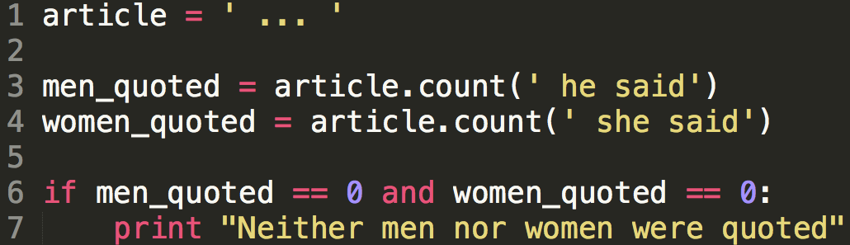
compound cONDITIONALS
Using the and keyword, both conditions must be true for the print statement at line 7 to run.

Slide 54
compound cONDITIONALS
Using the or keyword, either condition could be true for the print statement at line 2 to run.

Slide 55
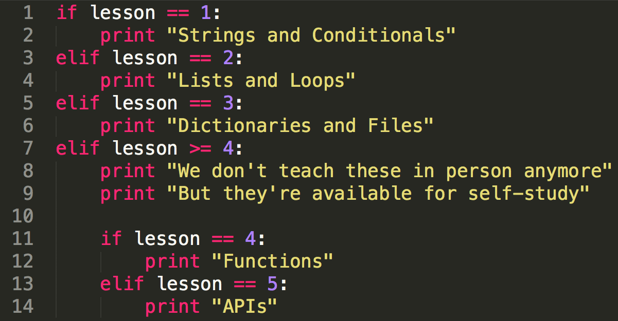
nested cONDITIONALS
Notes:
Explain how lines 8-14 will only run when the lesson is greater than or equal to four.

Slide 56
What can I do with python, though?
You'll use strings and conditionals in every Python program you write.
Here are a few examples:
Verify a social security number is valid
Edit a search to improve the results returned
Notes:
If there are other vetted demos from teaching assistants, this is a good time for them. Keep them short. If there are no other demos, just do these two.
If Suellen is there, have her demo and explain her social security example.
If Shannon is there, have her demo and explain her Bechdel test website.

Slide 57
Playtime!
Head to Hear Me Code's Slides on Github, which has examples & code samples for the lesson.
See the playtime folder for the playtime exercise for this lesson.
Notes:
When you get here, pivot to demos if there is time. After demos, bring it back here.
Be sure to open the playtime exercise and walk folks through how to get the code (Raw) and copy/paste it into Sublime or IDLE so they can get started on the exercise.

